Slide 1

Go Lang
What is that thing?

Slide 2

Notes:
Personal opinion
My history

Slide 3

History
Notes:
Starts on late 2007.
Became open source in November 2009
Today's version is 1.7.4
Key Players: Robert Griesemer (Hotspot, JVM) Rob Pike (58) (Unix/UTF-8) Kenneth Thompson (71) (B and C lang/Unix/UTF-8) Ian Lance Taylor (GCC) Russ Cox (Plan9/CSP)
Solve big problems at google such as: thousands of engineers, C++ on servers, distributed build system, maintainability, big scale

Slide 4

Philosophy
Notes:
Expressive
Comprehensive
Sophisticated

Slide 5

Features
Notes:
Garbage collection
Remote package management
Great builtins
No exceptions :O!
Among others...

Slide 6

General purpose

Slide 7

Compile

Slide 8

Strongly Typed

Slide 9

Batteries included
Notes:
Gzip
Reflect
Math
Unicode
Image
Net/mail
Net/http
Json
Crypto/Aes
HTML/Template
------------------
Live coding: webserver example from scratch -> interaction with log.fatal (ie 2 ws on the same port) - webserver.go

Slide 10
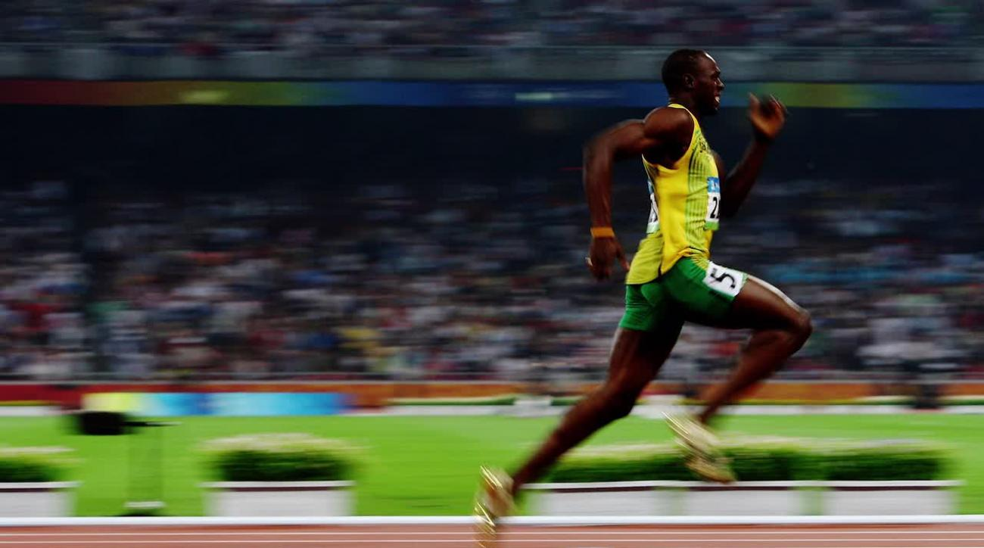
Fast
Notes:
https://benchmarksgame.alioth.debian.org/u64q/go.html
https://benchmarksgame.alioth.debian.org/u64q/compare.php?lang=go&lang2=node
http://benchmarksgame.alioth.debian.org/u64q/compare.php?lang=go&lang2=python3
http://benchmarksgame.alioth.debian.org/u64q/compare.php?lang=go&lang2=gpp
http://benchmarksgame.alioth.debian.org/u32/compare.php?lang=go&lang2=lua
https://github.com/google/grumpy

Slide 11

Goroutines
Notes:
You can define concurrents units of executions (concurrently execution functions)
Apps uses all cores - Can run on multiples cores at the same time
No limits
NON BLOCKING IO!!!
Can communicate & sync via channels
Demo -> 1 & 2 process - goroutine.go

Slide 12

Tools

Slide 13
go get
Notes:
~ go get github.com/gorilla/mux

Slide 14
go test
Notes:
Live coding: something_test.go example_test.go
go test example_test.go

Slide 15
go run

Slide 16
go build

Slide 17
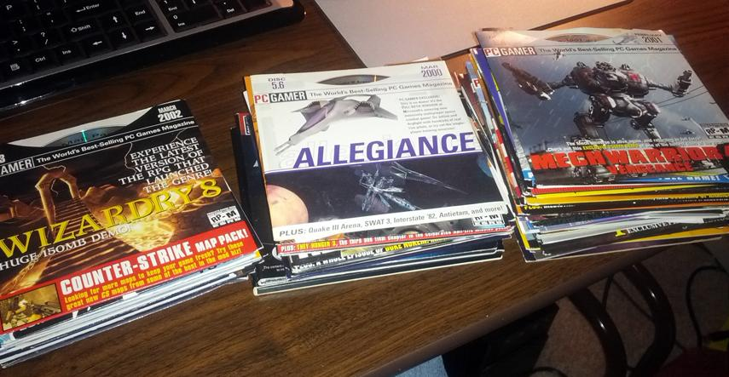
Demo Time

Slide 18

Notes:
Live coding:
Api.go
rest-api-starwars.go

Slide 19
Resources
https://golang.org/
https://tour.golang.org/welcome/1
http://www.golang-book.com/
https://gobyexample.com/
http://openmymind.net/The-Little-Go-Book/
https://blog.golang.org/

